Slide 1
Newborn assessment
Presented by Connie S. Kelling, WHNP, MSN, RN

Slide 2
Objectives:
Learn how to perform a comprehensive newborn assessment
Learn newborn vital sign normal parameters
Discuss gestational age assessments of the newborn
Learn how to perform APGAR scoring of a neonate
Discuss Safe Sleep guidelines

Slide 3
WHY?
To identify congenital anomalies that have yet to be detected
To be able to identify common neonatal problems
To identify potential problems based on family and pregnancy history
To allow opportunities for parents to ask questions
To initiate health promotion

Slide 4
What?
Prenatal data:
Maternal age
Family history
Drug or alcohol abuse
Gravidy/Parity: problems with previous pregnancies or pregnancy outcomes
Maternal history: chronic diseases, medications during pregnancy
Prenatal test results
Labor and delivery
Infant’s condition at birth: Apgars, resuscitation
Gestational age
Birth weight/order
Gender

Slide 5
Where?
Mother’s room
Adequate lighting needed
Comfort with exam
Able to answer questions during exam
Newborn Nursery
Best for first few exams
Discuss exam with mother when infant returned to room

Slide 6
How?
Observation
Head to toe
May listen to heart, lungs and bowel sounds at the beginning if infant is quiet
Be sure to keep infant warm

Slide 7
Normal Newborn Vital Signs:
Temperature: axillary 36.4-37.5
Heart rate: 110-160
Respiratory rate: 30-60
Blood Pressure: not routinely assessed in healthy newborns

Slide 8
Overall Appearance:
Observe infant in unwrapped state: check for symmetry
Observe respiratory rate and effort: note GFR, retractions
Tone – extremities should be flexed
Color – reddish pink: note jaundice, bruising, pallor or cyanosis
Movement – MAE: note difference in symmetrical movement

Slide 9
Other Common Tests:
Normal Glucose: within 2 hours of birth, above 45mmg%
done only with maternal risk factors or presence of clinical symptoms of hypoglycemia
Hyperbilirubinemia: based on age of infant, plotted on scale to determine risk level
at least one assessment of TCB unless ABO or Rh factor issues
Congenital Heart Defect (CHD)
Hearing Screening
Ohio Metabolic screen (PKU test)
Car Seat Challenge
Blood Type/Coombs

Slide 10
Head
Fontanels
Anterior – variable in size/diamond
Posterior – Small in size/triangle shape
Suture lines – Open or closed?
Sagittal suture line may be open, approximated or over-riding
Coronal sutures frequently over-riding

Slide 11
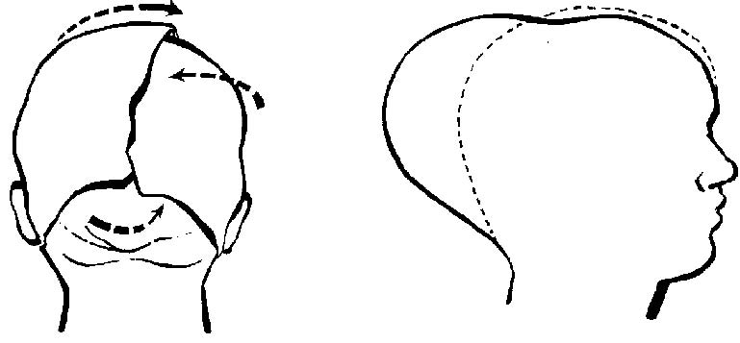
Check for presence of: molding – accommodation of head to pelvis for purpose of delivery

Slide 12
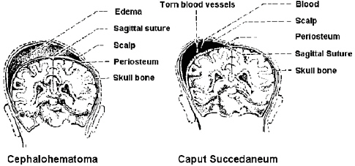
caput seccedaneum – crosses suture lines: “head mushiness” from delivery

Slide 13
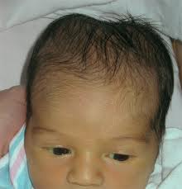
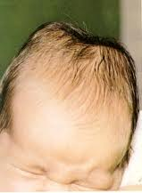
Cephalohematoma – does not cross suture lines: “antler-like”

Slide 14
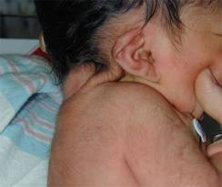
Extra neck folds

Slide 15
Eyes
Subconjunctival hemorrhages
Shape
Edema
Drainage
Bruising/forcep marks
Red reflex

Slide 16
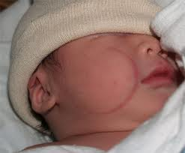
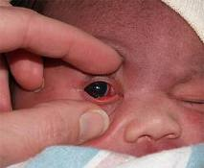
Sunconjuctival Hemorrhage
Forcep Marks

Slide 17
Ears
Shape – check pinna and lobe, symmetry
Size
Position – line from outer canthus of eye to ear placement: pinna should be at or above this line
Low placement or abnormal ears may be indicative of an abnormality
Check for tags/pits

Slide 18
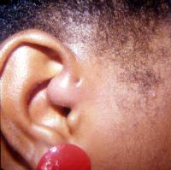
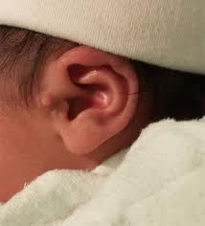
Ear Sinus Node
Ear Tag

Slide 19

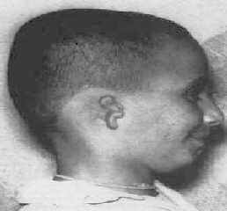
Low set Ears
Malformed Ears

Slide 20
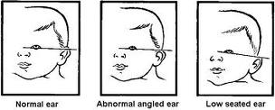
Ear set

Slide 21
Mouth and Palate
Check for intactness of lip/palate
Check soft palate/suck
Prenatal teeth
Epstein’s pearls – small white/yellow cystic papulescysts on median roof of palate

Slide 22
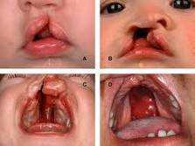
Cleft Lip and Palates

Slide 23
CHEST
Clavicles – check for intactness; crepitus
Respirations: 30-60/min
no GFR/stridor/retractions
Lung sounds: equal bilaterally, rales, rhonchi
Breast buds

Slide 24

SUPERNUMMARY NIPPLES

Slide 25
HEART
Heart sounds: check for murmur
Rate – 110-160 bpm
Rhythm should be regular
Pulses (brachial and femoral) should be equal upper and lower extremities

Slide 26
ABDOMEN
Shape: round, distended, flat, scaphoid
Texture: soft, firm, tender
Umbilicus: moist, dry, reddened, three vessels (2 arteries, 1 vein)
Bowel sounds: check all four quadrants
Hernia: umbilical

Slide 27
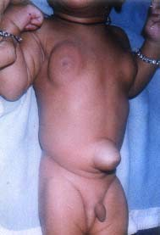
UMBILICAL HERNIA & ENGORGED BREASTS

Slide 28
Anogenital
Male infant- normal anatomy?
Penis:
Hypospadias
Circumcision
Scrotum:
Testes R and L
descended, in canal?
hydrocele R or L?

Slide 29
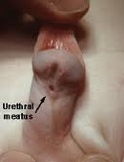
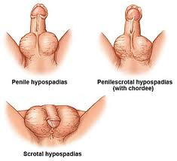
HYPOSPADIUS

Slide 30
Anogenital
Females
Normal anatomy: premature vs term
Hymenal tag (vag tag)
Discharge: mucus
Pseudo-menses

Slide 31
Anal patency
Should be assessed at time of delivery (rectal temp no longer done)
Type of stool: meconium, transitional, breast milk, formula
Should stool within 36 hours of birth
Should void within 24 hours of birth

Slide 32
EXTREMITIES
Be a parent!
Count fingers and toes!
Check for Simian creases
Check for polydactyly or syndactyly
Acrocyanosis
Range of motion
Abnormal foot positions: positional from delivery or club foot
“Breech babies” Are they kissing their toes?

Slide 33
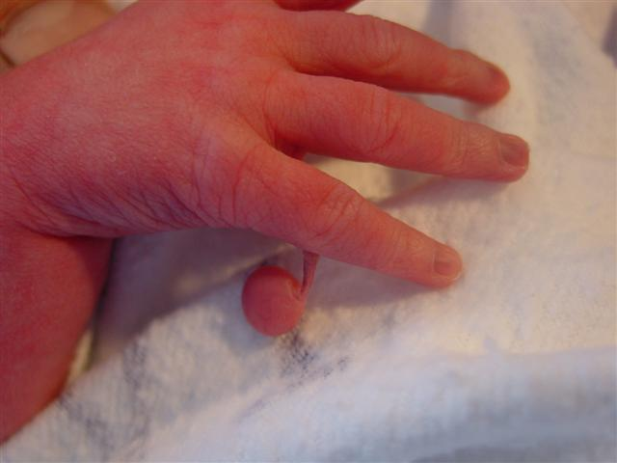
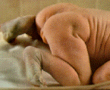
POLYDACTYLY/ACROCYANOSIS

Slide 34
BACK AND SPINE
Support neck and shoulders
Lift baby up and “dangle” in prone position
Examine spine for intactness and straightness: check for dimples and or tufts of hair at the sacrum
Baby should exhibit tone, no floppiness should be noted

Slide 35
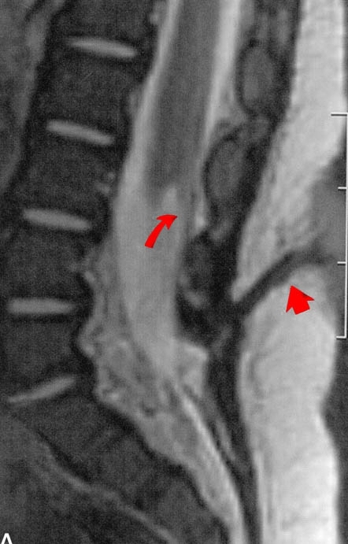
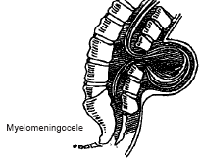
SPINAL DEFECTS

Slide 36
SKIN
Stork-bite marks (capillary hemangiomas)
Milia (benign white cysts – keratin and sebaceous material
Erythema Toxicum (newborn rash) white pinpoint with erythematous base
Breast enlargement – Witches milk
Mongolian/Cerulean spots
Lanugo - soft downy hair
Vernix caseosa – thick, white cheesylike substance

Slide 37
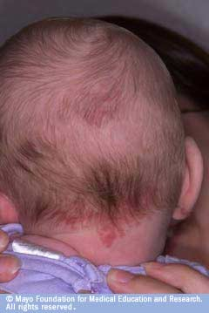
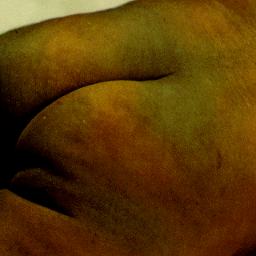
STORK BITES/MONGOLIAN

Slide 38
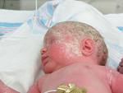
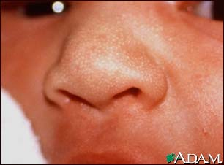
VERNIX/MILIA

Slide 39
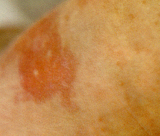
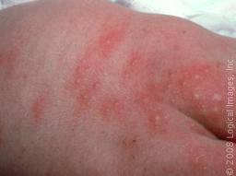
ERYTHEMA TOXICUM

Slide 40
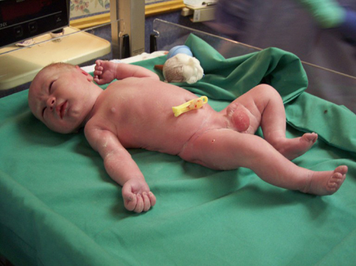
THE NEWBORN INFANT

Slide 41
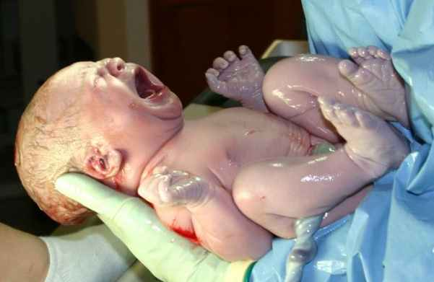

Slide 42
REFLEXES
Moro: startle
Tonic neck:
Palmer grasp (toes too!)
Step
Babinski
Rooting
Sucking

Slide 43
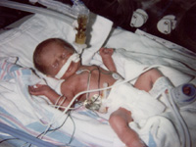
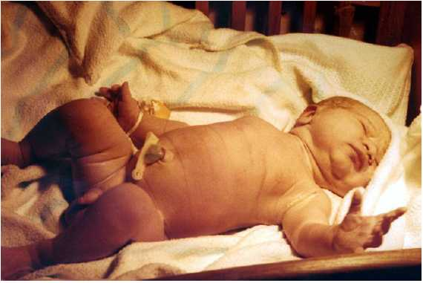
Gestational Age
Preterm
Fullterm

Slide 44
BALLARD SCALE
Neuromuscular
Posture
Square Window
Arm Recoil
Popliteal Angle
Scarf Sign
Heel to Ear
Physical Maturity
Skin
Lanugo
Plantar Creases
Breast
Ear
Genitals

Slide 45
NEUROMUSCULAR
POSTURE: The degree of extremity flexion – the greater the flexion, the more mature
POPLITEAL ANGLE: Angle of knees with thigh on chest –lesser the angle greater the maturity
SQUARE WINDOW –Flexion of arm to forearm – greater the flexion, greater the maturity
SCARF SIGN: Placing hand on opposite shoulder – lesser travel of elbow across midline, the greater the maturity
ARM RECOIL: Recoil of arms after extension – full recoil shows greater maturity
HEEL TO EAR: Non forceful movement of heel to ear – greater distance shows greater maturity

Slide 46
PHYSICAL
Skin: sticky, friable, transparent >leathery, cracked, wrinkled
Lanugo: none > abundant > mostly bald
Plantar surface: heel to toe 40-50mm (-1), less than 40mm (-2) > creases over entire sole
Breast: imperceptible > full areola 5-19 mm bud
Eye/Ear: lids fused, pinna flat, stays folded > thick cartilage
Genitalia/Male: scrotum flat, smooth > testes pendulous, deep rugae
Genitalia/Female: clitoris prominent, labia flat> majora covers clitoris and minora

Slide 47
Add scores of neuromuscular and physical maturity
Consult maturity rating scale and assign estimated gestational age (+ or – 2 weeks)
Plot weight, length and head circumference on graph according to YOUR estimation, not EDC
Helpful for diagnosing LGA and AGA as well
*Nurseries also plot weights on computerized growth charts and get a percentile for growth- useful for SGA and LGA

Slide 48
APGAR SCORES
Developed by Dr. Virginia Apgar in 1952
Used to quickly assess health of newborn children immediately after childbirth
Each component can be scored with a zero, 1 or 2
Scores range from 0-10 and are assessed at 1 and 5 minutes of age
If 5 minute score is less than 7, continue to score every 5 minutes until a 7 is reached or resuscitation is discontinued

Slide 49
APGAR Scoring:
APPEARANCE: assess skin color; 0 for blue all over, 1 for acrocyanosis, 2 for pink all over
PULSE: assess heart rate; 0 for absent, 1 for less than 100 bpm and 2 for 100 or more bpm
GRIMACE: assess reflex irritability; 0 for no response, 1 for grimace and/or feeble cry when stimulated, 2 for sneeze, cough or pulling away from stimulation
ACTIVITY: assess muscle tone; 0 for none, 1 for some flexion, 2 for active movement
RESPIRATIONS: assess breathing; 0 for no effort, 1 for weak or irregular, 2 for strong
Apgar scores ARE NOT used for criteria for resuscitation. Code pink ABCs (airway, breathing, circulation) are the determining factors for resuscitation
* Code Pinks utilize NRP (Neonatal Resuscitation Program) for neonatal resuscitation.

Slide 50
Safe sleep Infant suffocation vs sids

Slide 51
Safe Sleep Guidelines
https://www.injoyonline.com/learn/course/understanding-birth-stories-videos/birth-stories/safe-sleep

